Slide 1
Approach
Technologies used:
Building an app that allows the users to inform about the disaster activity in real-time to the rescue agencies.
Agencies to agencies communication for efficient management of resources
The nearest agency is contacted for immediate rescuing.
All the Agencies in a certain range are informed to be prepared.
Immediate medical backup is provided.
Frontend:
HTML
CSS
React
Java script
Backend:
Node JS
Express JS
Database:
MongoDB Atlas
API:
Open Street Map
News API
Use cases
Disaster Response Coordination
Emergency Evacuation Planning
Communication and Alerts
Medical Response
Volunteer Mobilization
Inter-Agency Communication
user-friendly portal

Slide 2
WORK FLOW
DESIGNING UI
DEVELOPMENT
DATA INTEGRATION
SECURITY
DEPLOYMENT
Dependencies
Data Sources and Integration
APIs and External Services
Network and Internet Infrastructure
Geospatial Data and Mapping
Security and Privacy Concerns
Funding and Resources
Emergency Service Coordination

Slide 3
Need of the solution
Natural disasters kill over 75000 people per year
Due to cold waves , lightning , heavy rains ,floods and landslides destroyed more than 2.3 million hectares of cropland is being demolished
India has been ranked no 3 after China and US in recording the highest no of natural Disasters
Economically India lost USD 6 billion due to disasters
Due to this there is a need for disaster management and quickly knowing about the disasters also for fast recovery and evacuation..

Slide 4
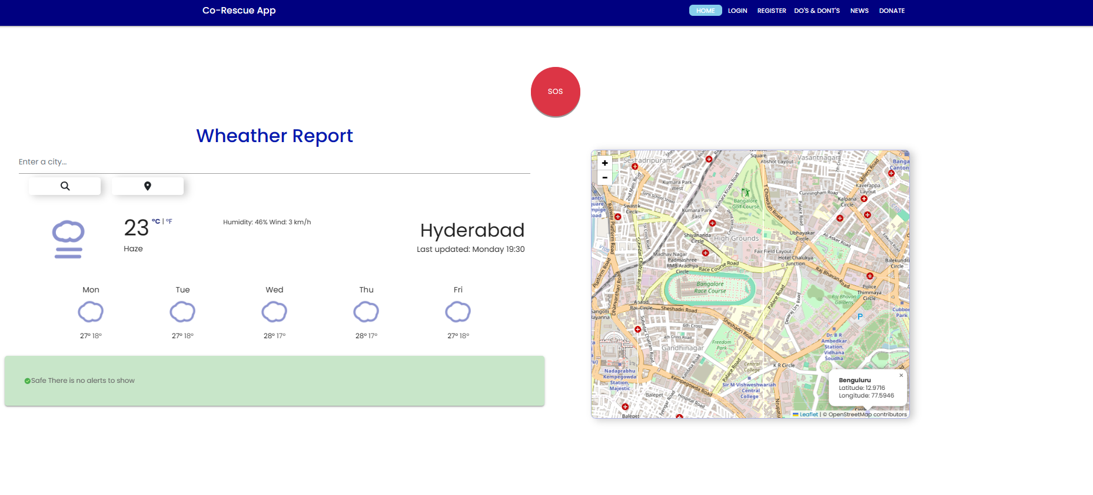
Working
User clicks SOS button
Our map navigator collects the GPS location and traces the latitude and longitude
The nearest five registered relief centers gets an alert message
Also the emails are sent to the rescue centers
Inter communication among the relief centers
Immediate essential backup is provided

Slide 5
Features
Weather Report:
The Weather Report feature displays upcoming weekend weather for a searched city, offering detailed forecasts to aid planning. Users can easily access weather information for any city, enhancing flexibility and preparedness for various locations.
Map Navigator:
Utilizing the OpenStreetMap API, the Map Navigator incorporates a SOS button to reveal nearby rescue locations during emergencies, providing users with critical information for swift decision-making and response.
Communication Between Relief & Communication Centers
This feature establishes seamless communication channels between relief centers, enabling efficient coordination, resource allocation, and real-time updates during emergency situations, thereby enhancing overall disaster response capabilities.

Slide 6
Features
News:
The News feature provides real-time updates on disasters, offering users current information on crisis situations. By displaying relevant news in a dedicated tab, users can stay informed about the latest developments, helping them make informed decisions and understand the extent of the impact.
Fund Generation:
Integrated with the UPI app scanner, the Fund Generation feature allows users to contribute seamlessly to disaster-affected areas. This user-friendly interface facilitates quick and secure donations, promoting a collective effort to support relief and recovery initiatives.
Do & Don’ts:
The Do & Don'ts feature educates users about appropriate actions during various disasters, presented in multiple languages for accessibility. By offering clear guidance on what to do and what to avoid, the feature enhances public awareness and preparedness, contributing to safer responses in the face of emergencies. Users gain valuable insights into effective measures for specific disasters, fostering a proactive approach to disaster management.

Slide 7
Features
Email Notification:
Expedite response and streamline coordination in emergencies by promptly dispatching SOS emails to the closest rescue agencies, optimizing communication channels for effective disaster response.
Alert Sound for Emergency:
Heighten situational awareness and aid by triggering an immediate alert system featuring a distinctive buzzer sound. This ensures swift notification of neighboring locations when an emergency arises.
User Authentication with OTP:
Fortify the security and integrity of your disaster management system through a stringent user verification process. Access is restricted to authenticated users who undergo a robust one-time-password (OTP) authentication, enhancing the overall reliability of the platform.

